Slide 1


Spring WEB
Maksym Oleshchuk
Senior Software Engineer
July 25, 2017

Slide 2
CONTENTS
1
Spring WEB introduction
2
WEB MVC
3
View technologies
4
WebSocket support

Slide 3
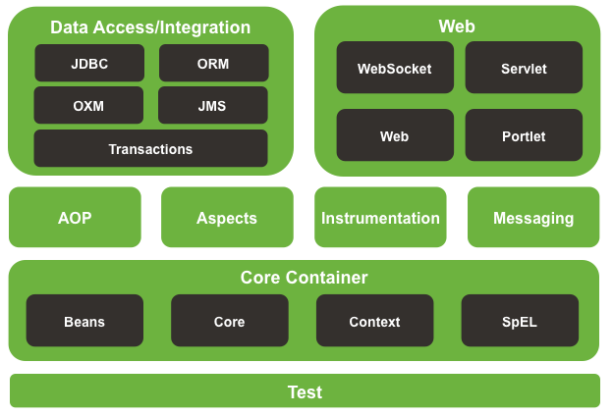
Intro

Slide 4
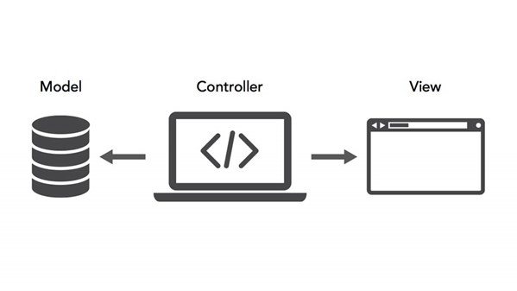
MVC

Slide 5
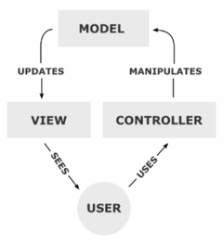
MVC
Notes:
Model-View-Controller (MVC, «Модель-Представление-Контроллер», «Модель-Вид-Контроллер») — схема разделения данных приложения, пользовательского интерфейса и управляющей логики на три отдельных компонента: модель, представление и контроллер — таким образом, что модификация каждого компонента может осуществляться независимо^{[1]}.
Модель (Model) предоставляет данные и реагирует на команды контроллера, изменяя свое состояние^{[1]}.
Представление (View) отвечает за отображение данных модели пользователю, реагируя на изменения модели^{[1]}.
Контроллер (Controller) интерпретирует действия пользователя, оповещая модель о необходимости изменений^{[1]}.

Slide 6

Spring MVC
Notes:
The Spring Web model-view-controller (MVC) framework is designed around a DispatcherServlet that dispatches requests to handlers, with configurable handler mappings, view resolution, locale, time zone and theme resolution as well as support for uploading files. The default handler is based on the @Controller and @RequestMapping annotations, offering a wide range of flexible handling methods. With the introduction of Spring 3.0, the @Controller mechanism also allows you to create RESTful Web sites and applications, through the @PathVariable annotation and other features.

Slide 7
Spring MVC features
Clear separation of roles
Powerful and straightforward
Flexibility
Reusable business code, no need for duplication
Customizable binding and validation
Customizable handler mapping and view resolution
Flexible model transfer
Customizable locale, time zone and theme resolution

Slide 8
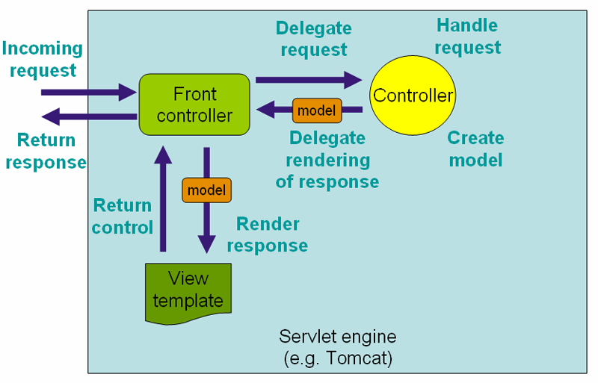
DispatcherServlet
Notes:
Spring’s web MVC framework is, like many other web MVC frameworks, request-driven, designed around a central Servlet that dispatches requests to controllers and offers other functionality that facilitates the development of web applications. Spring’s DispatcherServlet however, does more than just that. It is completely integrated with the Spring IoC container and as such allows you to use every other feature that Spring has.
The request processing workflow of the Spring Web MVC DispatcherServlet is illustrated in the following diagram. The pattern-savvy reader will recognize that theDispatcherServlet is an expression of the "Front Controller" design pattern (this is a pattern that Spring Web MVC shares with many other leading web frameworks).

Slide 9
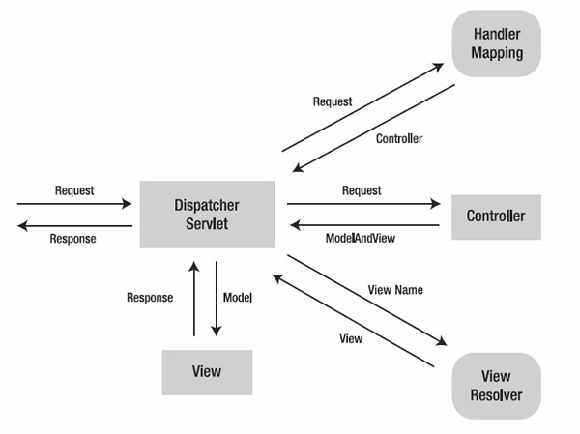
DispatcherServlet

Slide 10
DispatcherServlet init
Notes:
In the preceding example, all requests starting with /example will be handled by the DispatcherServlet instance named example.
WebApplicationInitializer is an interface provided by Spring MVC that ensures your code-based configuration is detected and automatically used to initialize any Servlet 3 container. An abstract base class implementation of this interface named AbstractAnnotationConfigDispatcherServletInitializer makes it even easier to register the DispatcherServlet by simply specifying its servlet mapping and listing configuration classes - it’s even the recommended way to set up your Spring MVC application. See Code-based Servlet container initialization for more details.
The DispatcherServlet is an actual Servlet (it inherits from the HttpServlet base class), and as such is declared in the web.xml of your web application. You need to map requests that you want the DispatcherServlet to handle, by using a URL mapping in the same web.xml file. This is standard Java EE Servlet configuration; the following example shows such a DispatcherServlet declaration and mapping:

Slide 11
DispatcherServlet init

Slide 12
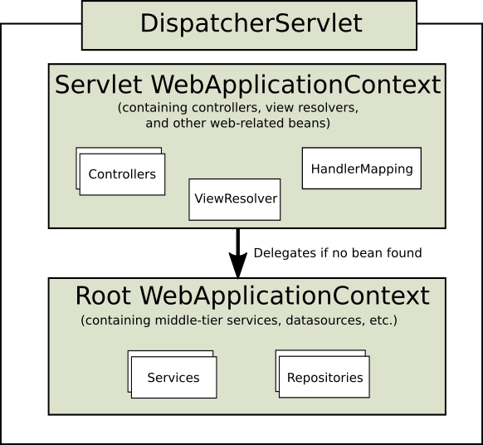
DispatcherServlet
Notes:
As detailed in Section 7.15, “Additional Capabilities of the ApplicationContext”, ApplicationContext instances in Spring can be scoped. In the Web MVC framework, each DispatcherServlet has its own WebApplicationContext, which inherits all the beans already defined in the root WebApplicationContext. The root WebApplicationContext should contain all the infrastructure beans that should be shared between your other contexts and Servlet instances. These inherited beans can be overridden in the servlet-specific scope, and you can define new scope-specific beans local to a given Servlet instance.

Slide 13
DispatcherServlet init
Notes:
Upon initialization of a DispatcherServlet, Spring MVC looks for a file named [servlet-name]-servlet.xml in the WEB-INF directory of your web application and creates the beans defined there, overriding the definitions of any beans defined with the same name in the global scope.
Consider the following DispatcherServlet Servlet configuration (in the web.xml file):

Slide 14
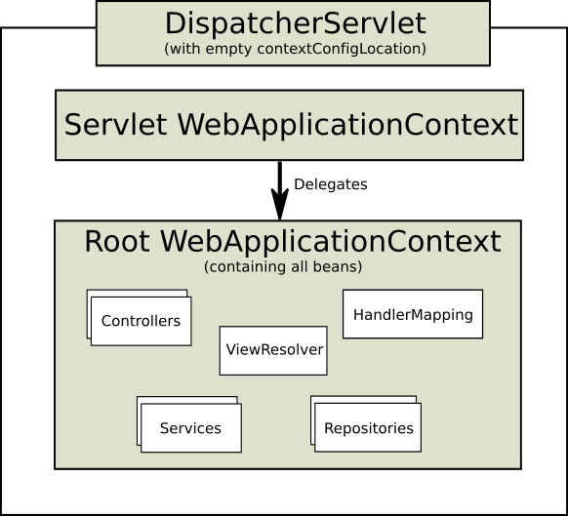
DispatcherServlet
Notes:
With the above Servlet configuration in place, you will need to have a file called /WEB-INF/golfing-servlet.xml in your application; this file will contain all of your Spring Web MVC-specific components (beans). You can change the exact location of this configuration file through a Servlet initialization parameter (see below for details).
It is also possible to have just one root context for single DispatcherServlet scenarios.
Figure 22.3. Single root context in Spring Web MVC

Slide 15
DispatcherServlet init
Notes:
This can be configured by setting an empty contextConfigLocation servlet init parameter, as shown below:
The WebApplicationContext is an extension of the plain ApplicationContext that has some extra features necessary for web applications. It differs from a normalApplicationContext in that it is capable of resolving themes (see Section 22.9, “Using themes”), and that it knows which Servlet it is associated with (by having a link to the ServletContext). The WebApplicationContext is bound in the ServletContext, and by using static methods on the RequestContextUtils class you can always look up the WebApplicationContext if you need access to it.

Slide 16
DispatcherServlet init
Notes:
Note that we can achieve the same with java-based configurations:

Slide 17
DispatcherServlet flow
The locale resolver is bound to the request
The theme resolver is bound to the request
If you specify a multipart file resolver, the request is inspected for multiparts
An appropriate handler is searched for. If a handler is found, the execution chain associated with the handler (preprocessors, postprocessors, and controllers) is executed in order to prepare a model or rendering.
If a model is returned, the view is rendered. If no model is returned, (may be due to a preprocessor or postprocessor intercepting the request, perhaps for security reasons), no view is rendered, because the request could already have been fulfilled.

Slide 18
Controllers
Notes:
Controllers provide access to the application behavior that you typically define through a service interface. Controllers interpret user input and transform it into a model that is represented to the user by the view. Spring implements a controller in a very abstract way, which enables you to create a wide variety of controllers.
Spring 2.5 introduced an annotation-based programming model for MVC controllers that uses annotations such as @RequestMapping, @RequestParam, @ModelAttribute, and so on. This annotation support is available for both Servlet MVC and Portlet MVC. Controllers implemented in this style do not have to extend specific base classes or implement specific interfaces. Furthermore, they do not usually have direct dependencies on Servlet or Portlet APIs, although you can easily configure access to Servlet or Portlet facilities.
As you can see, the @Controller and @RequestMapping annotations allow flexible method names and signatures. In this particular example the method accepts a Model and returns a view name as a String, but various other method parameters and return values can be used as explained later in this section. @Controller and @RequestMapping and a number of other annotations form the basis for the Spring MVC implementation. This section documents these annotations and how they are most commonly used in a Servlet environment.

Slide 19
Controllers
Notes:
The @Controller annotation indicates that a particular class serves the role of a controller. Spring does not require you to extend any controller base class or reference the Servlet API. However, you can still reference Servlet-specific features if you need to.
The @Controller annotation acts as a stereotype for the annotated class, indicating its role. The dispatcher scans such annotated classes for mapped methods and detects @RequestMapping annotations (see the next section).
You can define annotated controller beans explicitly, using a standard Spring bean definition in the dispatcher’s context. However, the @Controller stereotype also allows for autodetection, aligned with Spring general support for detecting component classes in the classpath and auto-registering bean definitions for them.
To enable autodetection of such annotated controllers, you add component scanning to your configuration. Use the spring-context schema as shown in the following XML snippet:

Slide 20
Controllers
Notes:
You use the @RequestMapping annotation to map URLs such as /appointments onto an entire class or a particular handler method. Typically the class-level annotation maps a specific request path (or path pattern) onto a form controller, with additional method-level annotations narrowing the primary mapping for a specific HTTP method request method ("GET", "POST", etc.) or an HTTP request parameter condition.
The following example from the Petcare sample shows a controller in a Spring MVC application that uses this annotation:
In the above example, @RequestMapping is used in a number of places. The first usage is on the type (class) level, which indicates that all handler methods in this controller are relative to the /appointments path. The get() method has a further @RequestMapping refinement: it only accepts GET requests, meaning that an HTTP GET for /appointments invokes this method. The add() has a similar refinement, and the getNewForm() combines the definition of HTTP method and path into one, so that GET requests for appointments/new are handled by that method.
The getForDay() method shows another usage of @RequestMapping: URI templates. (See the section called “URI Template Patterns”).

Slide 21
Controllers
Notes:
the getNewForm() combines the definition of HTTP method and path into one, so that GET requests for appointments/new are handled by that method.
The getForDay() method shows another usage of @RequestMapping: URI templates. (See the section called “URI Template Patterns”).

Slide 22
Controllers
Notes:
The get() method has a further @RequestMapping refinement: it only accepts GET requests, meaning that an HTTP GET for /appointments invokes this method. The add() has a similar refinement, and the getNewForm() combines the definition of HTTP method and path into one, so that GET requests for appointments/new are handled by that method.
The getForDay() method shows another usage of @RequestMapping: URI templates. (See the section called “URI Template Patterns”).

Slide 23
URI Template Patterns
Notes:
When a @PathVariable annotation is used on a Map<String, String> argument, the map is populated with all URI template variables.
A URI template can be assembled from type and method level @RequestMapping annotations. As a result the findPet() method can be invoked with a URL such as/owners/42/pets/21.
A @PathVariable argument can be of any simple type such as int, long, Date, etc. Spring automatically converts to the appropriate type or throws aTypeMismatchException if it fails to do so. You can also register support for parsing additional data types. See the section called “Method Parameters And Type Conversion” and the section called “Customizing WebDataBinder initialization”.

Slide 24
Cookie attribute
Notes:
The @CookieValue annotation allows a method parameter to be bound to the value of an HTTP cookie.
Let us consider that the following cookie has been received with an http request:
JSESSIONID=415A4AC178C59DACE0B2C9CA727CDD84The following code sample demonstrates how to get the value of the JSESSIONID cookie:

Slide 25
Request header
Notes:
The @RequestHeader annotation allows a method parameter to be bound to a request header.
Here is a sample request header:
Customizing data binding with @InitBinder
Annotating controller methods with @InitBinder allows you to configure web data binding directly within your controller class. @InitBinder identifies methods that initialize the WebDataBinder that will be used to populate command and form object arguments of annotated handler methods.
Such init-binder methods support all arguments that @RequestMapping methods support, except for command/form objects and corresponding validation result objects. Init-binder methods must not have a return value. Thus, they are usually declared as void. Typical arguments include WebDataBinder in combination with WebRequest or java.util.Locale, allowing code to register context-specific editors.

Slide 26
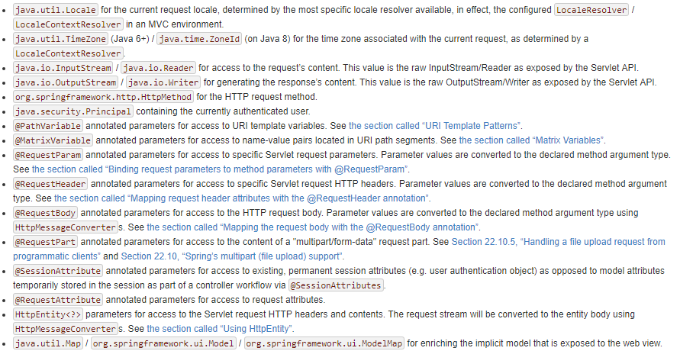
Method arguments

Slide 27
Response body
Notes:
The @ResponseBody annotation is similar to @RequestBody. This annotation can be placed on a method and indicates that the return type should be written straight to the HTTP response body (and not placed in a Model, or interpreted as a view name). For example:
The above example will result in the text Hello World being written to the HTTP response stream.
As with @RequestBody, Spring converts the returned object to a response body by using an HttpMessageConverter. For more information on these converters, see the previous section and Message Converters.

Slide 28
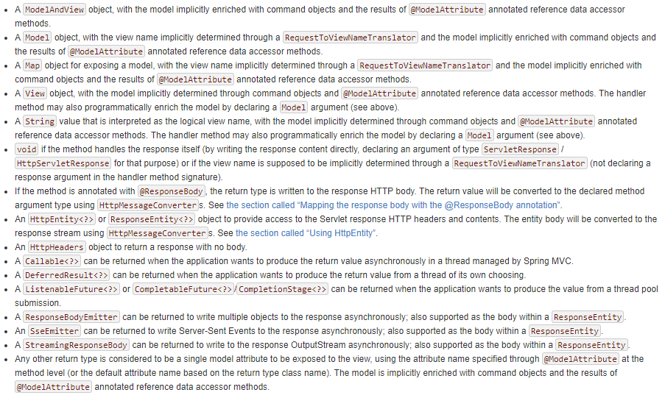
Return types

Slide 29
Cookie attribute
Notes:
It can sometimes be useful to filter contextually the object that will be serialized to the HTTP response body. In order to provide such capability, Spring MVC has built-in support for rendering with Jackson’s Serialization Views.
To use it with an @ResponseBody controller method or controller methods that return ResponseEntity, simply add the @JsonView annotation with a class argument specifying the view class or interface to be used:

Slide 30

EXCEPTION HANDLING
Business exception
HandlerExceptionResolver

Slide 31
EXCEPTION HANDLING APPROACHES
HandlerExceptionResolver
SimpleMappingExceptionResolver
Custom Resolver
@ExceptionHandler
Notes:
The HandlerExceptionResolver interface and the SimpleMappingExceptionResolver implementations allow you to map Exceptions to specific views declaratively along with some optional Java logic before forwarding to those views. However, in some cases, especially when relying on @ResponseBody methods rather than on view resolution, it may be more convenient to directly set the status of the response and optionally write error content to the body of the response.
You can do that with @ExceptionHandler methods. When declared within a controller such methods apply to exceptions raised by @RequestMapping methods of that controller (or any of its sub-classes). You can also declare an @ExceptionHandler method within an @ControllerAdvice class in which case it handles exceptions from @RequestMapping methods from many controllers. Below is an example of a controller-local @ExceptionHandler method:

Slide 32
SimpleMappingExceptionResolver
<bean id="simpleMappingExceptionResolver"
class="org.springframework.web.servlet.handler.SimpleMappingExceptionResolver">
<property name="exceptionMappings">
<map>
<entry key="DatabaseException" value="databaseError"/>
</map>
</property>
<property name="defaultErrorView" value="error"/>
<!-- Name of logger to use to log exceptions. Unset by default, so logging disabled -->
<property name="warnLogCategory" value=“com.epam.example.MvcLogger"/>
</bean>

Slide 33
CUSTOM EXCEPTION RESOLVER
public interface HandlerExceptionResolver {
ModelAndView resolveException(
HttpServletRequest request,
HttpServletResponse response,
Object handler,
Exception ex);
}
<?xml version="1.0" encoding="UTF-8"?>
<beans>
<bean class=“com.epam.example.CustomExceptionResolver">
</beans>

Slide 34
ANNOTATION BASED CONFIGURATION
@Controller
public class TicketController {
...
@ExceptionHandler(Exception.class)
@ResponseStatus(HttpStatus.INTERNAL_SERVER_ERROR)
public ModelAndView onServerException(Exception e) {
LOGGER.error("Internal server error while processing request", e);
return createResponse(HttpStatus.INTERNAL_SERVER_ERROR.toString(), e.getMessage());
}
}

Slide 35
ExceptionHandler

Slide 36

View

Slide 37




View

Slide 38
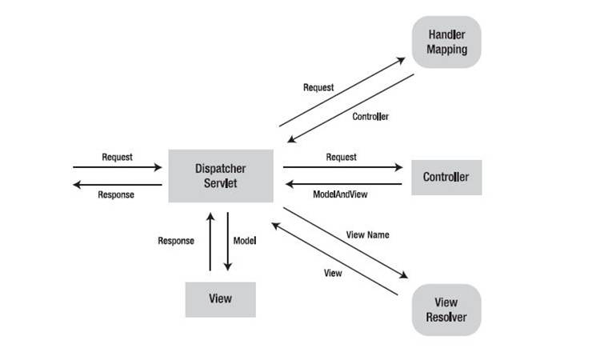
View

Slide 39
UrlBasedViewResolver
Notes:
As an example, with JSP as a view technology, you can use the UrlBasedViewResolver. This view resolver translates a view name to a URL and hands the request over to the RequestDispatcher to render the view.

Slide 40
Groovy Markup Templates

Slide 41
Groovy Markup Templates

Slide 42
Groovy Markup Templates

Slide 43
Velocity & FreeMarker

Slide 44
Velocity & FreeMarker
Notes:
Your templates need to be stored in the directory specified by the *Configurer bean shown above. This document does not cover details of creating templates for the two languages - please see their relevant websites for information. If you use the view resolvers highlighted, then the logical view names relate to the template file names in similar fashion to InternalResourceViewResolver for JSP’s. So if your controller returns a ModelAndView object containing a view name of "welcome" then the resolvers will look for the /WEB-INF/freemarker/welcome.ftl or /WEB-INF/velocity/welcome.vm template as appropriate.

Slide 45
Resource bundle view resolver
Notes:
Spring provides a couple of out-of-the-box solutions for JSP and JSTL views. Using JSP or JSTL is done using a normal view resolver defined in the WebApplicationContext. Furthermore, of course you need to write some JSPs that will actually render the view.
Just as with any other view technology you’re integrating with Spring, for JSPs you’ll need a view resolver that will resolve your views. The most commonly used view resolvers when developing with JSPs are the InternalResourceViewResolver and the ResourceBundleViewResolver. Both are declared in the WebApplicationContext:

Slide 46
JSP & JSTL
Notes:
As you can see, the ResourceBundleViewResolver needs a properties file defining the view names mapped to 1) a class and 2) a URL. With a ResourceBundleViewResolver you can mix different types of views using only one resolver.
The InternalResourceBundleViewResolver can be configured for using JSPs as described above. As a best practice, we strongly encourage placing your JSP files in a directory under the 'WEB-INF' directory, so there can be no direct access by clients.

Slide 47
Script templates
Notes:
It is possible to integrate any templating library running on top of a JSR-223 script engine in web applications using Spring. The following describes in a broad way how to do this. The script engine must implement both ScriptEngine and Invocable interfaces.
It has been tested with:
To be able to use script templates, you have to configure it in order to specify various parameters like the script engine to use, the script files to load and what function should be called to render the templates. This is done thanks to a ScriptTemplateConfigurer bean and optional script files.
For example, in order to render Mustache templates thanks to the Nashorn Javascript engine provided with Java 8+, you should declare the following configuration:

Slide 48
XML Marshalling View
Notes:
23.13 JSON Mapping View
The MappingJackson2JsonView uses the Jackson library’s ObjectMapper to render the response content as JSON. By default, the entire contents of the model map (with the exception of framework-specific classes) will be encoded as JSON. For cases where the contents of the map need to be filtered, users may specify a specific set of model attributes to encode via the RenderedAttributes property. The extractValueFromSingleKeyModel property may also be used to have the value in single-key models extracted and serialized directly rather than as a map of model attributes.
JSON mapping can be customized as needed through the use of Jackson’s provided annotations. When further control is needed, a custom ObjectMapper can be injected through the ObjectMapper property for cases where custom JSON serializers/deserializers need to be provided for specific types.
JSONP is supported and automatically enabled when the request has a query parameter named jsonp or callback. The JSONP query parameter name(s) could be customized through the jsonpParameterNames property.
23.14 XML Mapping View
The MappingJackson2XmlView uses the Jackson XML extension's XmlMapper to render the response content as XML. If the model contains multiples entries, the object to be serialized should be set explicitly using the modelKey bean property. If the model contains a single entry, it will be serialized automatically.
XML mapping can be customized as needed through the use of JAXB or Jackson’s provided annotations. When further control is needed, a custom XmlMapper can be injected through the ObjectMapper property for cases where custom XML serializers/deserializers need to be provided for specific types.

Slide 49
ContentNegotiatingViewResolver
Notes:
The ContentNegotiatingViewResolver does not resolve views itself but rather delegates to other view resolvers, selecting the view that resembles the representation requested by the client. Two strategies exist for a client to request a representation from the server:
Use a distinct URI for each resource, typically by using a different file extension in the URI. For example, the URI http://www.example.com/users/fred.pdf requests a PDF representation of the user fred, and http://www.example.com/users/fred.xml requests an XML representation.
Use the same URI for the client to locate the resource, but set the Accept HTTP request header to list the media types that it understands. For example, an HTTP request for http://www.example.com/users/fred with an Accept header set to application/pdf requests a PDF representation of the user fred, whilehttp://www.example.com/users/fred with an Accept header set to text/xml requests an XML representation. This strategy is known as content negotiation.

Slide 50

WebSocket support

Slide 51
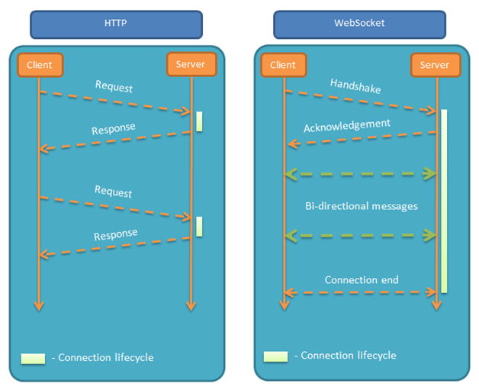
WebSocket support

Slide 52
Websocket conf
Notes:
Here can we see that the method configureMessageBroker is used to configure the message broker. First, we enable an in-memory message broker to carry the messages back to the client on destinations prefixed with “/topic”.
We complete our simple configuration by designating the “/app” prefix to filter destinations targeting application annotated methods (via @MessageMapping).
The registerStompEndpoints method registers the “/chat” endpoint, enabling Spring’s STOMP support. Keep in mind that we are also adding here an endpoint that works without the SockJS for the sake of elasticity.
This endpoint, when prefixed with “/app”, is the endpoint that the ChatController.send() method is mapped to handle.
It also enables the SockJS fallback options, so that alternative messaging options may be used if WebSockets are not available. This is useful since WebSocket is not supported in all browsers yet and may be precluded by restrictive network proxies.
The fallbacks let the applications use a WebSocket API but gracefully degrade to non-WebSocket alternatives when necessary at runtime.

Slide 53
Websocket conf
Notes:
As we’ve seen, Spring’s approach to working with STOMP messaging is to associate a controller method to the configured endpoint. This is made possible through the @MessageMapping annotation.
The association between the endpoint and the controller gives us the ability to handle the message if needed:
For the purposes of our example, we’ll create another model object named OutputMessage to represent the output message sent to the configured destination. We populate our object with the sender and the message text taken from the incoming message and enrich it with a timestamp.
After handling our message, we send it to the appropriate destination defined with the @SendTo annotation. All subscribers to the “/topic/messages” destination will receive the message.

Slide 54
QUESTIONS

